Slide 1
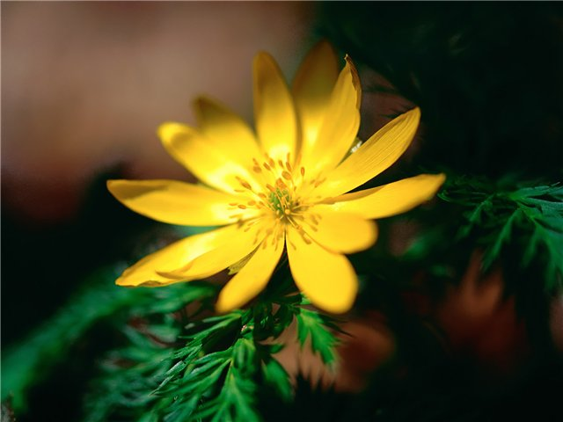
Protection of the nature

Slide 2
If we cut down fewer forests, the air would be clean and fresh.

Slide 3
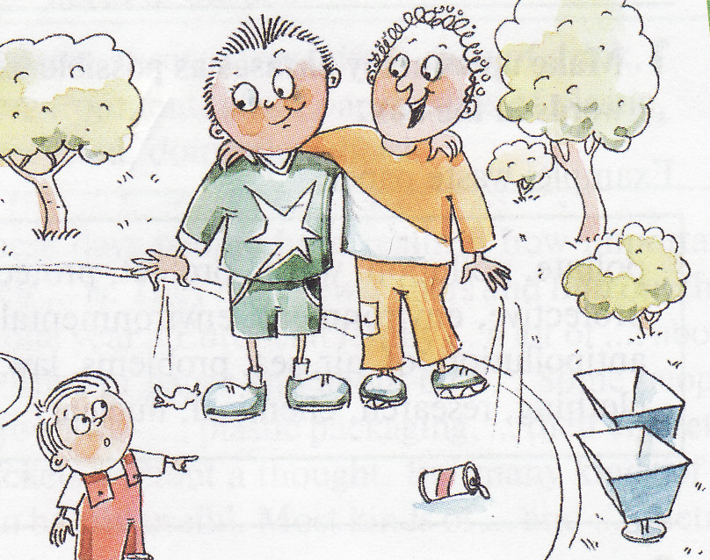
Never drop litter
We live among litter and wastes which we have created ourselves.

Slide 4
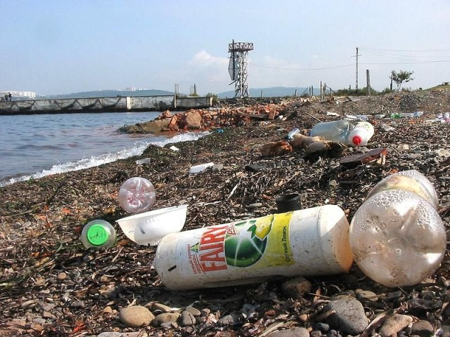
If we were clever and careful, we wouldn’t live among litter and waste.

Slide 5
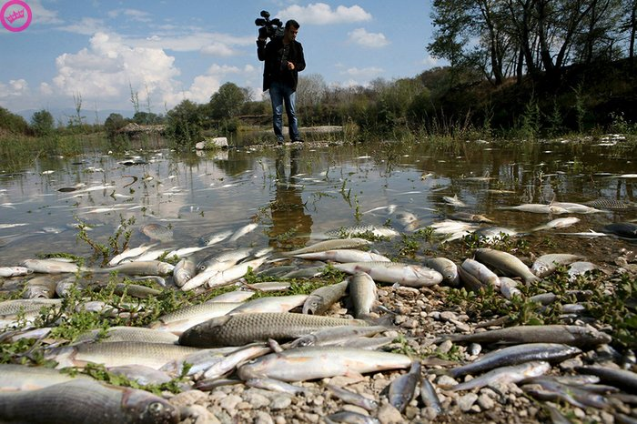
If we didn’t pollute our rivers and lakes, they would be full of fish.

Slide 6
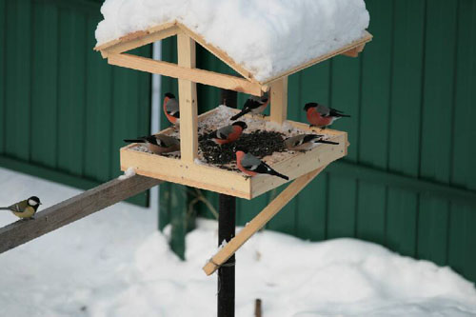
Put out food for wild animals in winter

Slide 7
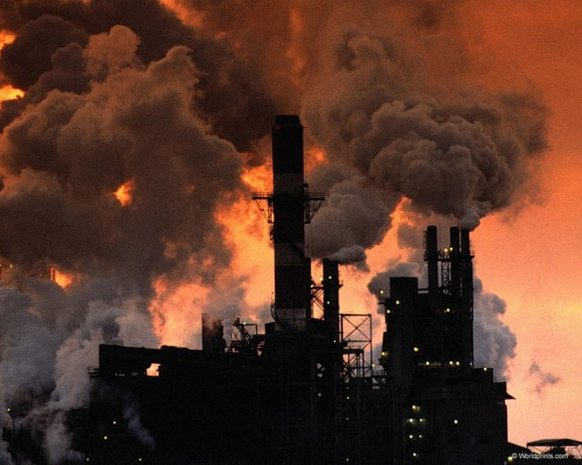
If people hadn’t invented different machines and developed industry, the environmental problems wouldn’t have appeared.

Slide 8
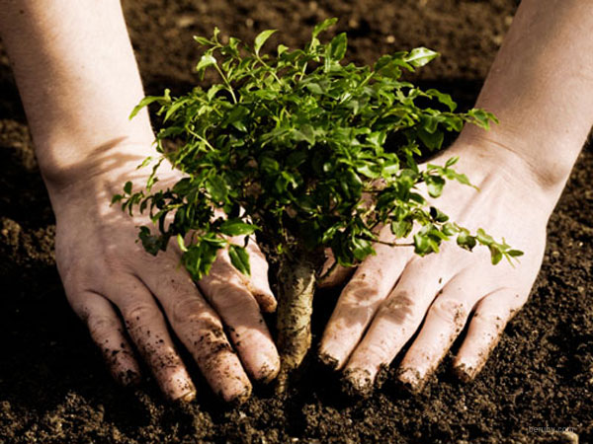
If we planted more new forests, we would save wild animals.

Slide 9
Walk or cycle whenever possible

Slide 10
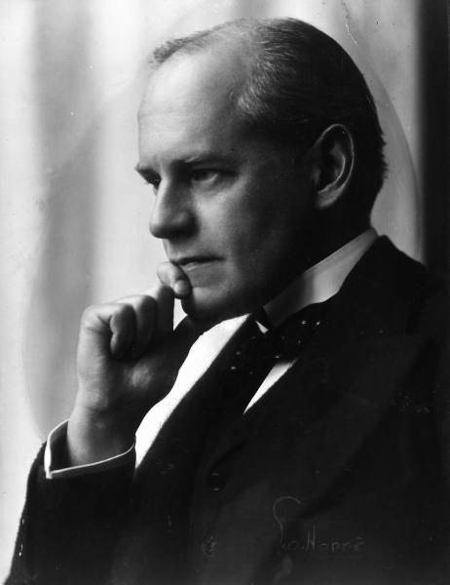
We should always remember the wise advice of a great English writer John Galsworthy who said: “If you don’t think about the future you will not have it.”

Slide 11
Thanks for attention!

